Slide 1
What is UML?
1.2
Unified Modelling Language (UML) is a general purpose visual modelling language
Can support all existing lifecycles
Intended to be supported by CASE tools
Unifies past modelling techniques and experience
Incorporates current best practice in software engineering
UML is not a methodology!
UML is a visual language
UP is a methodology

Slide 2
UML history
1.3
Fusion
1st unification
attempt
OMT, Booch, CRC
UML
work begins
Object
Management
Group RFP
UML proposal
accepted by
OMG
UML 1.x
UML 2.0
Schlaer/
Mellor
Prehistory
Booch
Rumbaugh
(OMT)
1995
1994
1996
1997
2003
2004
Jacobson
(Objectory)
Booch &
Rumbaugh
(OMT) join
Rational
Jacobson
(Objectory)
joins
Rational
UML
becomes
an industry
standard
Ongoing UML development
Coad/
Yourdon

Slide 3
Goals of UML as stated by the designers are
-To model systems using OO concepts
-To establish an explicit coupling to conceptual as well as executable artifacts
-To address the issues of scale inherent in complex, mission-critical systems
-To create a modeling language usable by humans and machine

Slide 4
To model systems using OO concepts
Specifying the structure and behavior of a system
Visualizing a system as it is or as we want it to be
Constructing a system from the template provided by the model
Documenting the decisions made

Slide 5
State
Diagrams
State
Diagrams
Class
Diagrams
Use Case
Diagrams
Use Case
Diagrams
State
Diagrams
Use Case
Diagrams
Use Case
Diagrams
State
Diagrams
Use Case
Diagrams
Object
Diagrams
Sequence
Diagrams
Scenario
Diagrams
State
Diagrams
Scenario
Diagrams
State
Diagrams
Collaboration
Diagrams
Component
Diagrams
Models
Scenario
Diagrams
Component
Diagrams
Scenario
Diagrams
Component
Diagrams
Statechart
Diagrams
Deployment
Diagrams
Activity
Diagrams

Slide 6
Three part of system’s model
Functional model
-Use case diagram
2. Object model
-Class diagram
3.Dynamic model
-sequence, Activity, State

Slide 7
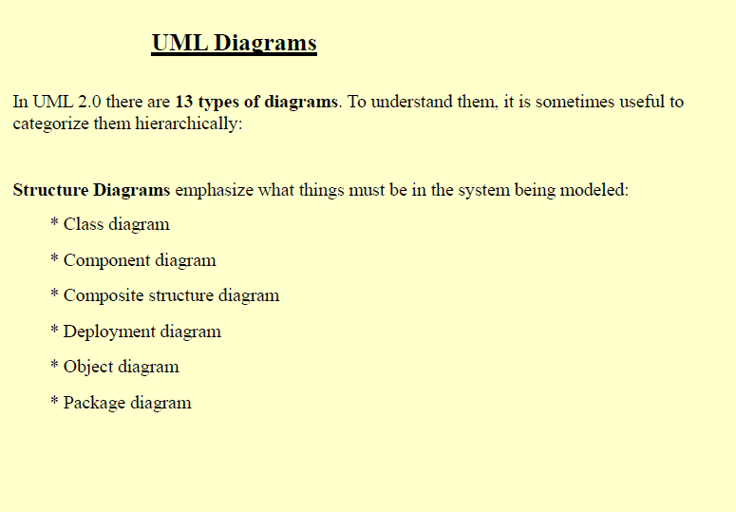

Slide 8
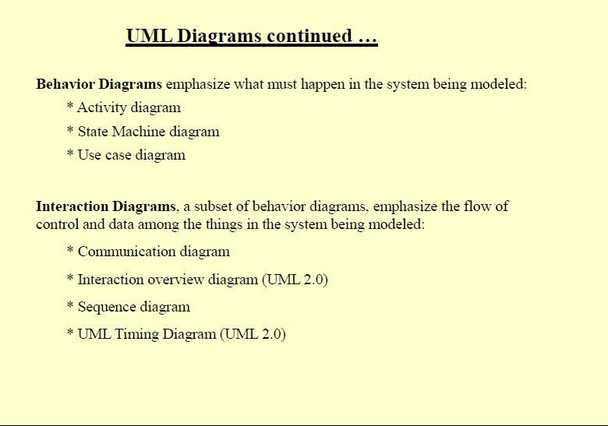

Slide 9
Objects and the UML
1.6
UML models systems as collections of objects that interact to deliver benefit to outside users
Static structure
What kinds of objects are important
What are their relationships
Dynamic behaviour
Lifecycles of objects
Object interactions to achieve goals

Slide 10
UML Structure
1.7
Structure consists of
Architecture
Building blocks
Common mechanisms

Slide 11
Use case
Elements
Actor
State
Name
Class
Attributes
Method

Slide 12
Use case

Slide 13
UML building blocks
1.8
Things
Modelling elements
Relationships
Tie things together
Diagrams
Views showing interesting collections of things
Are views of the model

Slide 14
Things
1.8.1
Structural things – nouns of a UML model
Class, interface, collaboration, use case, active class, component, node
Behavioural things – verbs of a UML model
Interactions, state machine
Grouping things
Package
Annotational things
Notes
package
Some Information about a thing

Slide 15
Relationships
1.8.2
relationship
UML syntax
brief semantics
dependency
The source element depends on the target element and may be affected by changes to it.
association
The description of a set of links between objects
aggregation
realization
A relationship between classifiers where one classifier
specifies a contract that the other classifier guarantees
to carry out
generalization
One element is specialization of another and may
be substituted for more general element

Slide 16
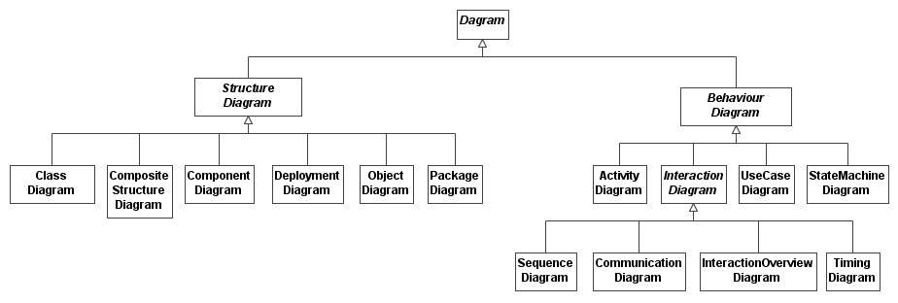
UML has 13 types of diagram
1.8.3
Structure diagrams model the structure of the system (the static model)
Behavior diagrams model the dynamic behavior of the system (the dynamic model)
Each type of diagram gives a different type of view of the model

Slide 17
UML common mechanisms
1.9
UML has four common mechanisms that apply consistently throughout the language:
Specifications
Adornments
Common divisions
Extensibility mechanisms

Slide 18
Specifications
1.9.1
semantic backplane
BankAccount
name
accountNumber
icon or modeling element
Class specification
deposit()
withdraw()
calculateInterest()
Deposit
Use case specification
Dependency specification
Behind every UML modelling element is a specification which provides a textual statement of the syntax and semantics of that element
These specifications form the semantic backplane of the model

Slide 19
Adornments
1.9.2
Every UML modelling element starts with a basic symbol to which can be added a number of adornments specific to that symbol
We only show adornments to increase the clarity of the diagram or to highlight a specific feature of the model
Window
Window
{author = Jim, status = tested}
+size : Area=(100,100)
#visibility : Boolean = false
+defaultSize: Rectangle
#maximumSize : Rectangle
-xptr : XWindow*
+create()
+hide()
+display( location : Point )
-attachXWindow( xwin : XWindow*)

Slide 20
Common divisions
1.9.3
Classifier and instance
A classifier is an abstraction, an instance is a concrete manifestation of that abstraction
The most common form is class/object e.g. a classifier might be a BankAccount class, and an instance might be an object representing my bank account
Generally instances have the same notation as classes, but the instance name is underlined
Interface and implementation
_The principle here is to separate what something does (its interface) from how it does it (its implementation)
An interface declares a contract and an implementation represents a concrete realization of that contract
BankAccount
balance
getBalance()
«instantiate»
myAccount:BankAccount
balance = 100.0
Borrowable
LibraryItem

Slide 21
Extensibility mechanisms
1.9.4
note
«entity»
Ticket {version = 1.1}
stereotype
constraint
{ each Ticket has a unique id }
tagged value
id
Constraints
Extends the semantics of an element by allowing us to add new rules about the element
Written as { some constraint }
Stereotypes
A stereotype allows us to define a new UML modelling element based on an existing one
We define the semantics of the stereotype ourselves
Stereotypes add new elements to the UML metamodel
Written as «stereotypeName»
<< >> called as guillemots
Tagged values
Allows us to add new, ad-hoc information to an element’s specification
Written as { tag1 = value1, tag2 = value2 … }

Slide 22
Stereotype syntax options
1.9.4.2
stereotype name
in guillemets
«entity» Ticket
stereotype
preferred
stereotype icon
preferred
icon
Ticket
stereotype name and icon
«entity»
Ticket
stereotyped
relationship
«control»
JobManager
«call»
Scheduler
A stereotype introduces a new modelling element and so we must always define semantics for our stereotypes
Each model element can have many stereotypes

Slide 23

Student
{Roll number is unique}
RollNumber
Name
Branch
<<class>>

Slide 24
UML profiles
1.9.4.4
A profile customizes UML for a specific purposes
A UML profile is a collection of stereotypes, tagged values and constraints
The tagged values and constraints are associated with stereotypes
Stereotypes extend one of the UML meta-model elements (e.g. Class, Association)
Any element that gets the stereotype also gets the associated tagged values and constraints

Slide 25
Architecture
1.10
system assembly configuration management
vocabulary functionality
Design view
Implementation view
Use case view
behaviour
Process view
Deployment view
performance scalability throughput
system topology distribution delivery installation
“4+1” view of Architecture

Slide 26
Model Driven Architecture
The Model-Driven Architecture (MDA) is a software design approach that was officially launched in 2001 by its sponsor, the Object Management Group (OMG).
MDA is intended to support model-driven engineering of software systems. The MDA is a specification that provides a set of guidelines for structuring specifications expressed as models
Model-Driven Engineering (or MDE) refers to the systematic use of models as primary engineering artifacts throughout the engineering lifecycle.

Slide 27
Model-Driven Architecture (MDA)
In MDA, platform-independent models (PIMs) are initially expressed in a platform-independent modeling language, such as UML.
The platform-independent model is subsequently translated to a platform-specific model (PSM) by mapping the PIM to some implementation language or platform (e.g., Java) using formal rules
MDA
Platform
Independent
Model
map
Platform
Specific
Model
generate
Code
deploy

Slide 28
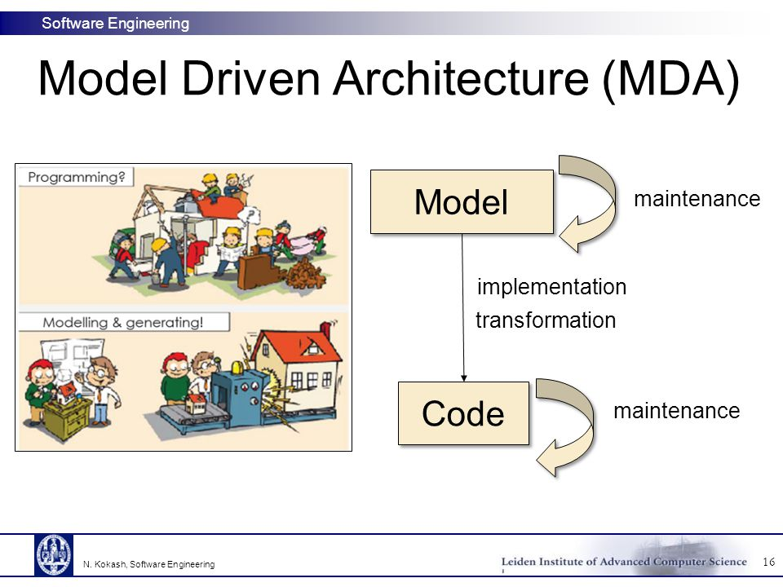

Slide 29
Summary
1.11
The UML is composed of building blocks:
Things
Relationships
Diagrams
The UML has four common mechanisms:
Specifications
Adornments
Common divisions
Extensibility mechanisms
The UML is based on a 4+1 view of system architecture

